Slide 1
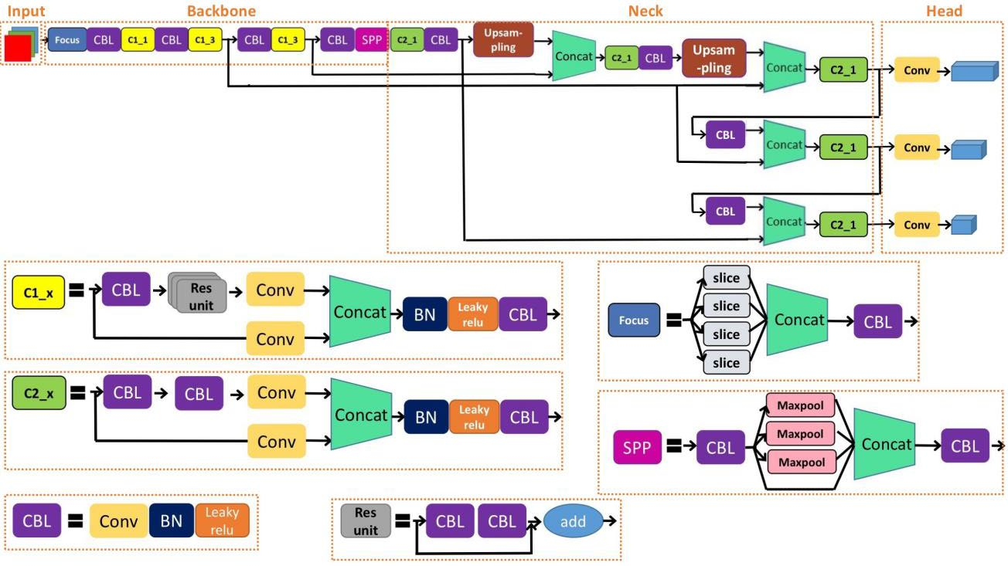
Architecture used in the Paper

Slide 2
Dataset details
KITTI dataset, which contains 7481 road images
Cyclist dataset, which contains 13.7K image

Slide 3
Implementation details
Use google drive and Colab to handle the run process.
Make a function for plotting the bounding box.
Split data and shuffle it.
Split data to train and test, validation, test size = 20%, validation size = 10%.
Clone the repo from GitHub and train the model with our new dataset.
Evaluate model with plot recall, precision, confusion matrix.

Slide 4
Results and visualizations

Slide 5
Results and visualizations
Recall: 0.846
Precision: 0.895
mean average precision in confidence threshold 50 (map50): 0.911
average mean average precision in confidence thresholds from 50 to 95 (map50-95): 0.714

Slide 6
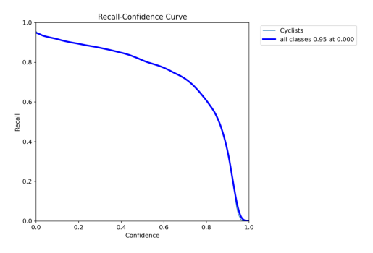
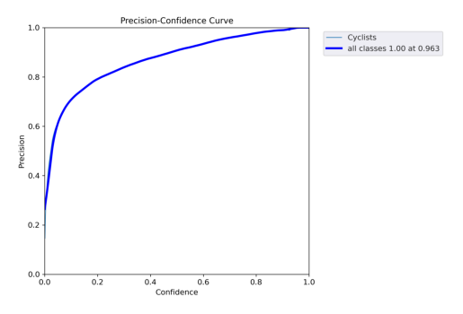
Results and visualizations
Recall confidence plot
Precision confidence plot

Slide 7
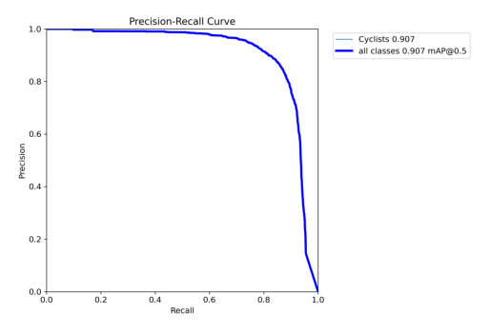
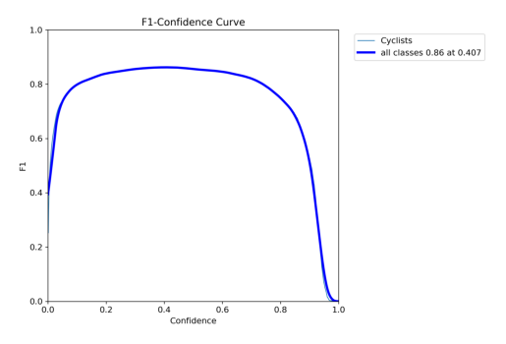
Results and visualizations
Precision-Recall curve
F1-Score confidence curve

Slide 8
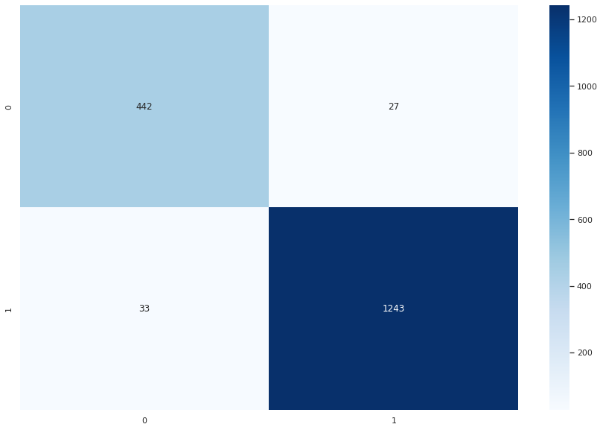
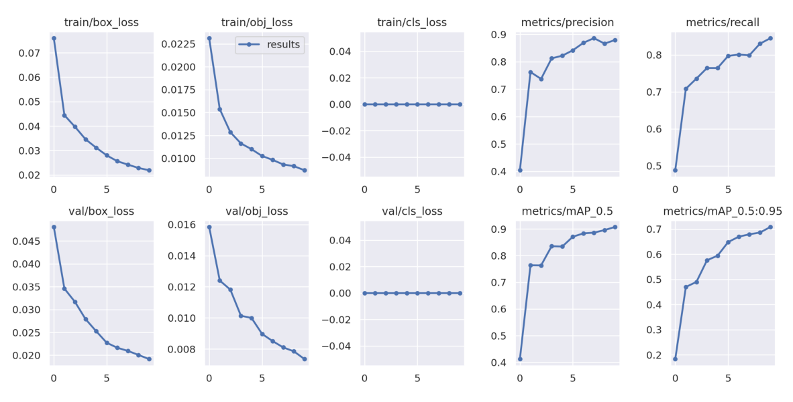
Results and visualizations
Confusion matrix
Result Vs Epochs

